Slide 1

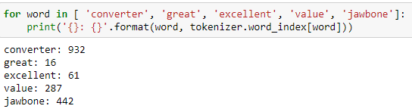
Implementation(2)-Reputation
Implemented: Comment emotion classifier
1. Training data collection - amazon_cells_labelled.txt
From https://github.com/microsoft/ML-Server-Python-Samples/blob/master/microsoftml/202/data/sentiment_analysis/amazon_cells_labelled.txt
2. Data processing with keras.preprocessing.text.Tokenizer
Form dictionary for training data
Convert training data into numpy arrays, using dictionary indexes replace words

Slide 2
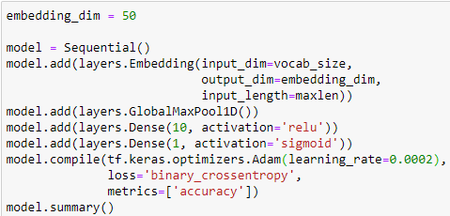

Implementation(2)-Reputation
3. Model designed & trained
Design each layer of model, modify Gradient descent optimizer
Train model, adjust model until expected prediction accuracy achieved
To be implemented
4. provide API servers to B-bay website, in order to get input comments and output predictions
5. Compute Reputation based on number of positive/negative comments
6. Display Reputation

Slide 3

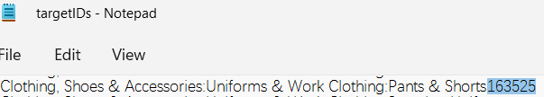
Implementation(3)-Search Recommendation
Implemented: Searched target tag classifier
1. Training data collection – from https://github.com/eBay/Sequence-Semantic-Embedding/blob/master/rawdata-classification/DataSet.tar.gz
2. Data processing with keras.preprocessing.text.Tokenizer
3.1 Model designed
Design each layer of model, modify Gradient descent optimizer
To be implemented:
3.2 Model training
4. provide API servers to B-bay website, in order to get input keyword and output tag
5. Let website display recommendations of search based on returned tag
6. Update training data based on selling requests from seller.

